Slide 1
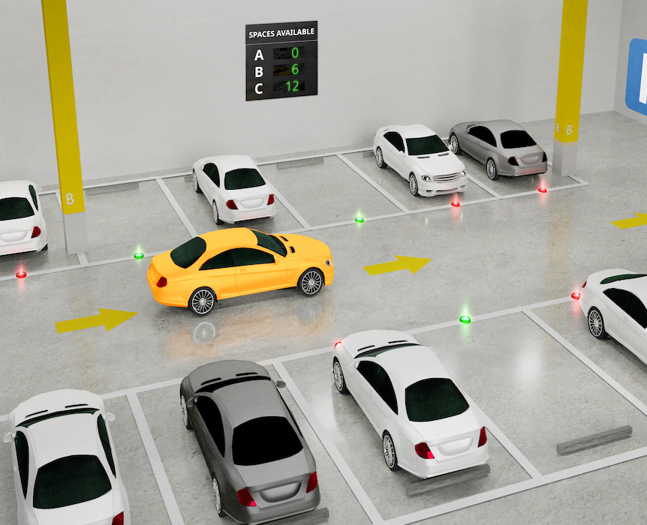

Smart Car Parking Management System
Presenter:
Tamanna Akter (221-15-5298)
Sadia Akter(221-15-5800)
Sanjida Abedin Mim (221-15-6019)
Rafi Ibn Anwar Labib(221-15-6016)
Abdullah Al Noman(221-15-5856)

Slide 2
Problem & Motivation
Parking congestion and time wasted finding empty slots
Need for a low-cost, easy-to-deploy solution
Real-time display of available spots
Scalable for small garages, campuses, events

Slide 3
Research Gap
Limited scalability: Many demos handle only 2–4 slots; lack modular designs for N slots
Sensor robustness untested: Few studies compare IR vs ultrasonic/camera under sunlight, dust, temperature
Sparse networking/IoT: Minimal work on Wi-Fi/LoRa integration for central dashboards and alerts
Safety & fail-safes: Little emphasis on gate obstruction detection, emergency overrides, watchdogs
Performance metrics missing: Few publish latency, accuracy, and power consumption benchmarks
UI/UX standardization: Inconsistent on-site signage and user feedback patterns
Reproducibility: Limited open datasets/code for independent validation
Our focus: A modular, low-cost baseline with clear interfaces, measurable metrics, and upgrade paths to IoT

Slide 4
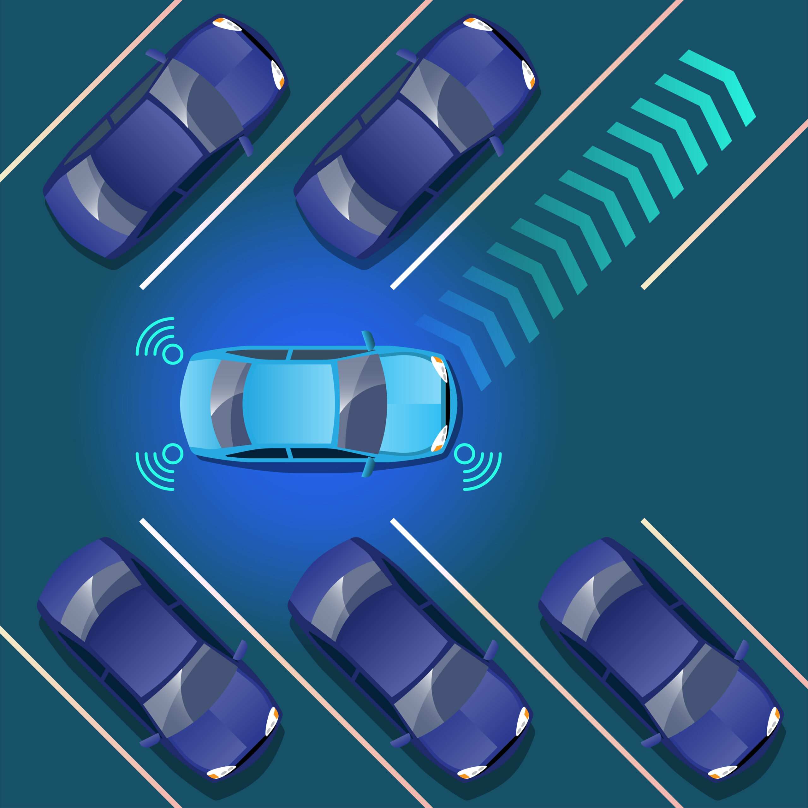
System Overview
Inputs: 4 × IR sensors (detect car presence)
Controller: Arduino (reads sensors, computes availability)
Outputs: I²C LCD 16×2 shows slot status/availability
Optional: Servo gate control + Buzzer alerts
Core logic: Occupied = S1+S2+S3+S4, Available = 4 − Occupied

Slide 5
Block diagram
IR sensor 1
LCD Display​
Arduino Uno
IR sensor 2
IR sensor n
Power Supply

Slide 6

Hardware Components
Arduino Uno/Nano (Serial @ 9600)
IR Sensors ×4: Digital pins D5, D6, D7, D8
I²C LCD 16×2: Address 0x27 (SDA/SCL)
Power: 5V regulated supply, jumper wires
Optional: Servo motor for gate, Buzzer, LED indicators

Slide 7
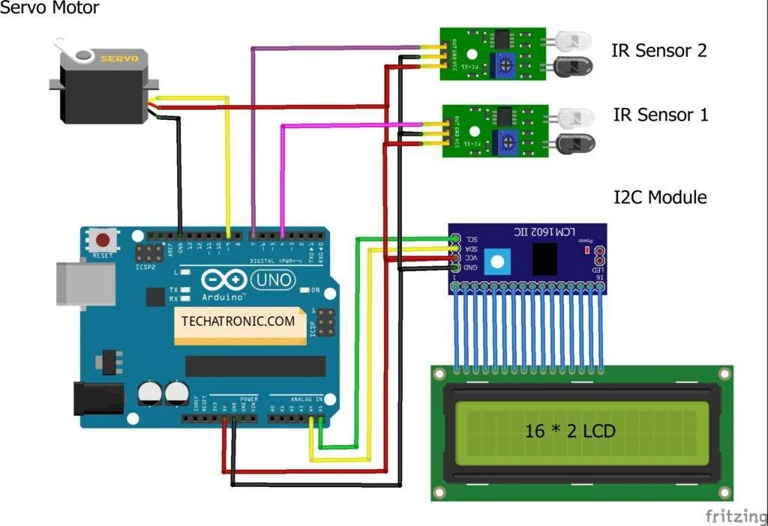
Circuit & Pin Mapping
IR Sensors → D5 (S1), D6 (S2), D7 (S3), D8 (S4)
LCD (I²C) → SDA/SCL pins (per Arduino board)
Power: Sensors + LCD from 5V & GND (common ground)
Best practices: Pull-ups if needed, short sensor cables, tidy wiring

Slide 8
Firmware Logic (Pseudo)
setup(): Serial.begin(9600), lcd.init(), lcd.backlight(), pinModes
Welcome screens (brief delays), then loop
loop():
Read S1..S4 → compute Occupied & Available
Update LCD lines (status + count)
(Optional) If Available == 0 → lock gate / buzzer ON
Key funcs: Read_Sensor(), updateLCD()

Slide 9
LCD UI & Messages
Line 1: “Parking Status | Slots: n”
Line 2: “S1:S2:S3:S4 (E/O)” or “Welcome / Full / Space Available”
Example:
Slots: 3 | S: E E O E (E=Empty, F=Full)
Parking FULL when Available == 0

Slide 10
Testing & Results
Scenarios: No cars → 4 available; random occupancy; full lot
Validation: Compare LCD vs actual slots
Serial Monitor: Log sensor states & computed counts
Outcome: Correct detection and immediate LCD updates

Slide 11
Limitations & Mitigations
IR false triggers (lighting, angle) → sensor shielding, calibration
Wiring noise → proper grounding, shorter leads
Power dips → stable 5V regulator/USB power
Scale limit (4 slots in demo) → extend to N sensors with arrays/mux

Slide 12

Future Upgrades & Conclusion
Upgrades: RFID access, mobile/web dashboard, cloud logging, camera/ULTRASONIC sensors, servo gate with safety
Integration: Wi-Fi/LoRa for remote monitoring
Conclusion: Low-cost, real-time, scalable parking assistant
Next: Live demo & Q&A

Slide 13


